Slide 1





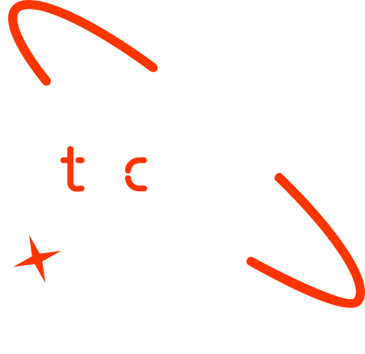

CLINICAL DECISION SUPPORT SYSTEM
Using Retrieval-Augmented Generation (RAG)
Group 1

Slide 2

Outline
RAG
Benefits of RAG
Applications of RAG
Concept note and implementation plan
Background
Objectives
SDG Relation
Data
Data Collection
Exploratory Data Analysis Feature Engineering
Model
Model Selection and Training
Model Evaluation and Hyperparameter Tuning
Model Refinement and Testing
Results
Evaluation Results
Deployment
Future Work

Slide 3
RAG
Retrieval Augmented Generation (RAG) is an AI technique that combines information retrieval with text generation to improve the accuracy and reliability of LLMs (Large Language Models). It works by augmenting an LLM with a way to retrieve and incorporate new information from external sources, making it more grounded in a specific body of knowledge.
How it works:
Retrieval Module : Retrieves relevant documents or information from a knowledge base based on a user's query or prompt.
Augmentation : This retrieved information is then used as context for the LLM to generate a response.
Generation: The LLM uses the retrieved information to generate a more accurate and relevant response, potentially with fewer hallucinations.
Notes:
FTs like precision agriculture, remote sensing & AI-powered forming equipment can help increase agricultural productivity in LDCs. This can improve fiid security & contribute to the achievement of SDG 2 (Zero Hunger).

Slide 4
Benefits of RAG
Improved accuracy and reliability
Access to up-to-date information
Reduced training costs
Enhanced user experience
Applications of RAG:
Chatbots and Knowledge Management
Customer Service
Legal Research:
Healthcare
Notes:
FTs like precision agriculture, remote sensing & AI-powered forming equipment can help increase agricultural productivity in LDCs. This can improve fiid security & contribute to the achievement of SDG 2 (Zero Hunger).

Slide 5
Concept note and Implementation Plan
This project introduces an AI-powered Clinical Decision Support System (CDSS) that uses Retrieval-Augmented Generation (RAG) to help healthcare professionals make accurate, evidence-based decisions.
By integrating medical textbooks, this system aims to:
Enhance clinical decision-making
Reduce misdiagnoses
Improve patient outcomes
Goals and Objectives
Retrieve relevant medical information from textbooks
Generate reliable, context-aware clinical recommendations
Minimize diagnostic errors and improve treatment accuracy
Notes:
FTs like precision agriculture, remote sensing & AI-powered forming equipment can help increase agricultural productivity in LDCs. This can improve fiid security & contribute to the achievement of SDG 2 (Zero Hunger).

Slide 6

SDG Relation
Sustainable Development Goal (SDG) 3: Good Health and Well-being
Relevance: Enhances access to reliable medical information, supporting health professionals to make informed decisions.
Impact: Empowers users in underserved areas with limited healthcare access to understand medical conditions.
Sustainable Development Goal (SDG) 4: Quality Education
Relevance: Serves as an educational tool for medical students or patients learning about health topics.
Implementation: Aligns with SDGs by ensuring factual responses and a scalable, cloud-based platform.

Slide 7
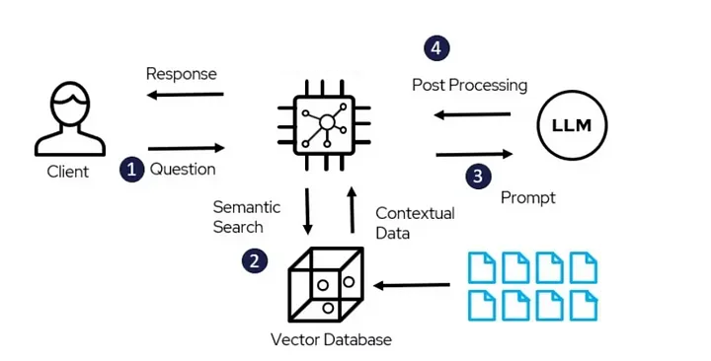
System Design and Implementation
High-Level Architecture
Textbooks
Notes:
FTs like precision agriculture, remote sensing & AI-powered forming equipment can help increase agricultural productivity in LDCs. This can improve fiid security & contribute to the achievement of SDG 2 (Zero Hunger).

Slide 8
Tech stack:
LangChain: Orchestrates the RAG pipeline, handling retrieval and generation.
Pinecone: A cloud-based vector database for storing and querying document embeddings, enabling fast similarity search for the RAG pipeline
Streamlit: Provides a user-friendly web interface
Hugging Face Embeddings: Encodes documents and queries for semantic search.
Gemini : Runs the gemini-1.5-flash model for response generation
Notes:
FTs like precision agriculture, remote sensing & AI-powered forming equipment can help increase agricultural productivity in LDCs. This can improve fiid security & contribute to the achievement of SDG 2 (Zero Hunger).

Slide 9
Data
Notes:
FTs like precision agriculture, remote sensing & AI-powered forming equipment can help increase agricultural productivity in LDCs. This can improve fiid security & contribute to the achievement of SDG 2 (Zero Hunger).

Slide 10
Data Collection
Source: 17 annotated medical textbooks, as a text file
Collection Process:
Documents aggregated from open-access medical repositories
Preprocessed using gensim (tokenization) and textblob (cleaning).
Storage: Documents embedded with sentence-transformers (all-MiniLM-L6-v2) and indexed in Pinecone (bot index).
Volume: total 80 Mb dataset size.
Ethical Considerations: Ensured no personal health information (PHI) is included to comply with privacy regulations.
Notes:
FTs like precision agriculture, remote sensing & AI-powered forming equipment can help increase agricultural productivity in LDCs. This can improve fiid security & contribute to the achievement of SDG 2 (Zero Hunger).

Slide 11
Exploratory Data Analysis and Feature Engineering
Exploratory Data Analysis (EDA):
Analyzed document length and vocabulary size, using gensim.
Normalizing white spaces, converting text to lowercase, and removing punctuation to ensure consistency
Feature Engineering:
Converted documents to 384-dimensional embeddings using sentence-transformers.
Chunked long documents into smaller segments (200 tokens) to fit Pinecone’s indexing limits.
To avoid API rate limits, we implemented a batch uploading mechanism.
Tools: Jupyter notebooks and Google Colab for EDA, as well as tqdm for tracking preprocessing progress.
Notes:
FTs like precision agriculture, remote sensing & AI-powered forming equipment can help increase agricultural productivity in LDCs. This can improve fiid security & contribute to the achievement of SDG 2 (Zero Hunger).

Slide 12
Model

Slide 13
Model Selection and Training
Model Architecture: RAG pipeline combining retrieval and generation.
Retrieval: PineconeVectorStore with sentence-transformers embeddings, similarity search (k=3).
Generation: Google Gemini (gemini-1.5-flash) via ChatGoogleGenerativeAI
Training
Training: No local training required; used pre-trained all-MiniLM-L6-v2 for embeddings and Gemini’s pre-trained Model.
Configuration: System prompt enforces context-only responses with a medical disclaimer.
Notes:
FTs like precision agriculture, remote sensing & AI-powered forming equipment can help increase agricultural productivity in LDCs. This can improve fiid security & contribute to the achievement of SDG 2 (Zero Hunger).

Slide 14
Model Evaluation and Hyperparameter Tuning
Hyperparameter Tuning:
Adjusted Gemini temperature (0.4 for factual responses) and max_output_tokens (500).
Tested Pinecone k values (3) to balance retrieval accuracy and latency.
Optimized embedding chunk size (300-500 tokens) for Pinecone indexing.
Notes:
FTs like precision agriculture, remote sensing & AI-powered forming equipment can help increase agricultural productivity in LDCs. This can improve fiid security & contribute to the achievement of SDG 2 (Zero Hunger).

Slide 15
Model Refinement and Testing
Refinement:
Improved system prompt to ensure empathetic tone and strict context adherence.
Optimized preprocessing with gensim to reduce noise in embeddings.
Performed end-to-end testing with sample queries (e.g., “What are diabetes symptoms?”).
Outcomes: Achieved stable performance with minimal hallucination, ready for deployment.
Notes:
FTs like precision agriculture, remote sensing & AI-powered forming equipment can help increase agricultural productivity in LDCs. This can improve fiid security & contribute to the achievement of SDG 2 (Zero Hunger).

Slide 16
Results
Notes:
FTs like precision agriculture, remote sensing & AI-powered forming equipment can help increase agricultural productivity in LDCs. This can improve fiid security & contribute to the achievement of SDG 2 (Zero Hunger).

Slide 17
Evaluation Results
End-to-End:
Average latency: 3-5 seconds. (Depending on the bandwidth)
95% of responses included the correct disclaimer.
Challenges: Occasional Pinecone API rate limits; mitigated with retry logic.
Notes:
FTs like precision agriculture, remote sensing & AI-powered forming equipment can help increase agricultural productivity in LDCs. This can improve fiid security & contribute to the achievement of SDG 2 (Zero Hunger).

Slide 18
Deployment
Platform: Streamlit Cloud (primary), with AWS EC2 as an alternative for future scalability.
Process:
Pushed repository (app.py, requirements.txt, .env) to GitHub.
Deployed via Streamlit Cloud with API keys stored in environment variables.
Security:
Encrypted API keys with Python-dotenv and Streamlit Cloud settings.

Slide 19
Future Work
Enhancements:
Implement a token-based approach with Graph RAG for dynamic context updates during generation.
Explore local alternatives (e.g., FAISS) to reduce Pinecone costs.
Add multilingual support for broader accessibility.
Finalize deployment and monitoring setup.
Address cost and latency challenges.
Expand features for broader impact.

Slide 20
References
Streamlit. (2025). Streamlit Documentation. https://docs.streamlit.io/
LangChain. (2025). LangChain Documentation. https://python.langchain.com/docs/
Pinecone. (2025). Pinecone Documentation. https://docs.pinecone.io/
Google Cloud. (2025). Google Generative AI API Documentation. https://cloud.google.com/ai/generative-ai
Rehurek, R., & Sojka, P. (2010). Software Framework for Topic Modelling with Large Corpora. LREC 2010 Workshop.
Loria, S. (2018). TextBlob: Simplified Text Processing. https://textblob.readthedocs.io/
Notes:
FTs like precision agriculture, remote sensing & AI-powered forming equipment can help increase agricultural productivity in LDCs. This can improve fiid security & contribute to the achievement of SDG 2 (Zero Hunger).

Slide 21


Thank you!

